Slide 1

Group 4
Abdulaziz Alqahtani 202200576

Slide 2
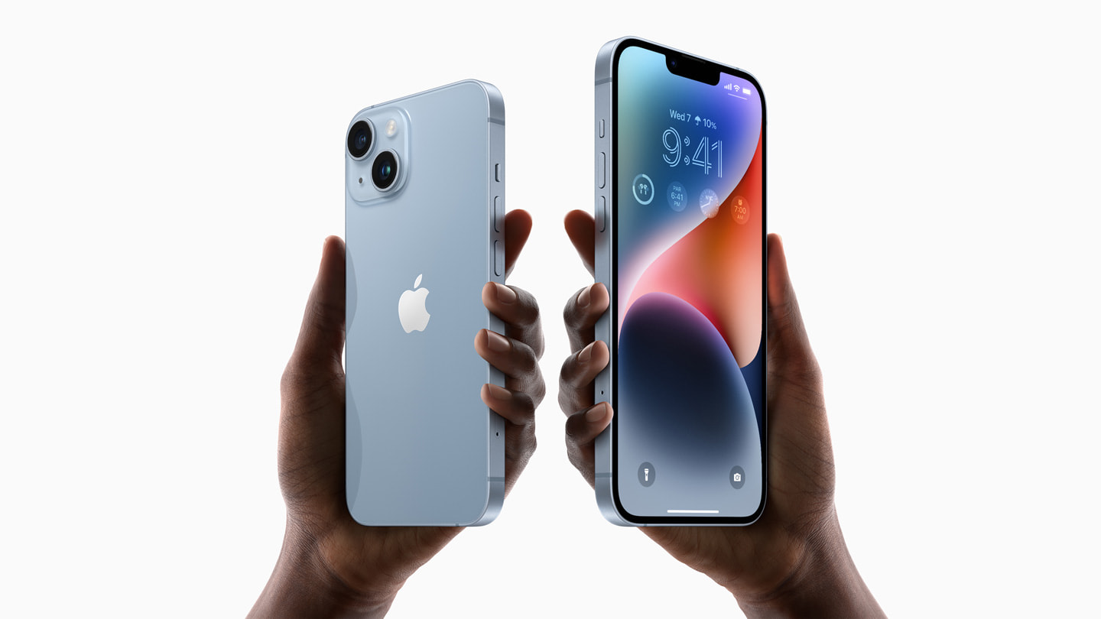
Analyzing apple’s new iPhone ad
https://www.youtube.com/watch?v=RL8sM6FuPw8&ab_channel=JackPurcher

Slide 3
Describe the key elements of the ad in your own words. What is it doing visually? In terms of sound? What is the “plot” or development?
The key elements that the ad interact with the people in a fast pace.
Visually it looks appealing because of the changing colors in the video , also the iPhone it self change in position throw out the ad
In term of sound they have picked a song that have a fast pace and sync it with the visual effect with the video, so anyone is watching will feel enthusiastic with the ad.
The plot of the ad is to show all the available option with different colors and highlight the changes to the new ios system that have been released with the iPhone

Slide 4
What elements are used to get the audience’s attention?
1- enthusiastic song
2- appealing visuals with simple background
3- fast pace so it does not feel boring for the viewer

Slide 5
Who, would you guess, is it trying to convince? What is the target audience? Consider age, gender, and other relevant factors. Note: the target audience is almost never “everybody.”
It is a hard question because in case of age it starts from 4 to 100
Gender it can be both male and female
People who wants to upgrade their old phone

Slide 6
Overall, how effective do you think this advertisement is? Would you buy the product? Do you think other people would buy it? Are there ways in which it is more effective and ways in which it is less effective? (E.g. catching your attention, convincing you to buy, creating a feeling, appealing to a specific audience, etc.)
I would say that it is effective and it pulls you into getting to know more about the iPhone
I would consider buying it if I don’t have a new phone
Perfect ad

Slide 7
Overall, do you think the advertisement is honest or deceptive? Why? Would this influence your decision to support this brand?
This ad is more about showing the available options so it is honest because they have nothing to hide they show everything about the iPhone visually
I see that Apple branding is one of the best in the world, and their numbers talk for themselves

